Slide 1
Advanced Machining Processes
Manufacturing Processes

Slide 2

Outline
Chemical Milling
Photochemical Blanking
Electrochemical Machining
Pulsed Electrochemical Machining
Electrochemical Grinding
Electrical-Discharge Machining
Electrical-Discharge Grinding
Electrical-Discharge Wire Cutting
Laser-Beam Machining
Electron Beam Machining
Plasma Arc Cutting
Water Jet Machining
Abrasive Water Jet Machining
Abrasive Jet Machining

Slide 3
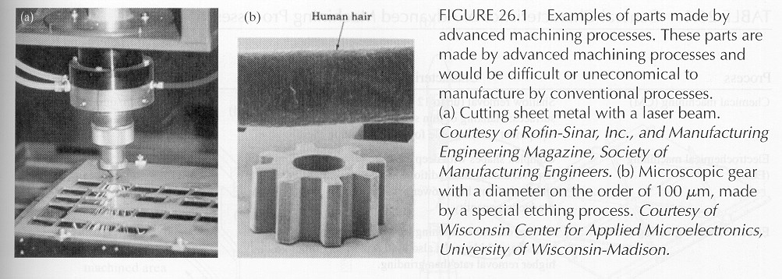
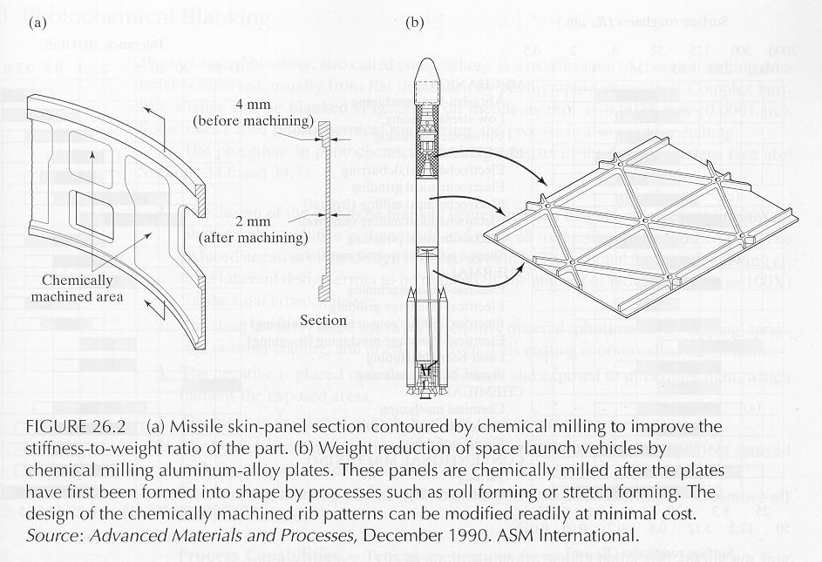
Examples of Parts

Slide 4
Chemical Milling
Produces shallow cavities on a workpiece, usually to reduce weight
The area affected by the chemical reagent is controlled by masking or by partial immersion

Slide 5
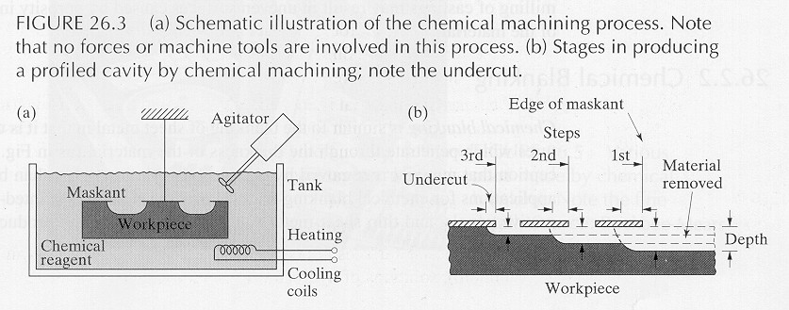
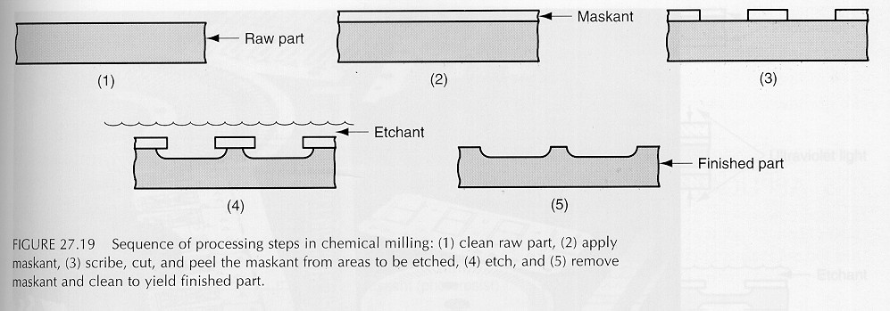
Chemical Milling

Slide 6
Chemical Milling
Procedure:
Relieve residual stresses to prevent warping
Clean the material surface
Apply masking material
Remove the masking on regions that require etching
Apply the reagents
Wash the part
Remove remaining masking
Additional finishing or chemical milling procedures may be used

Slide 7
Photochemical Blanking
Uses chemicals and photographic processes to remove material, usually from a thin sheet
Can produce complex shapes on metals as thin as .0025 mm without forming burrs

Slide 8
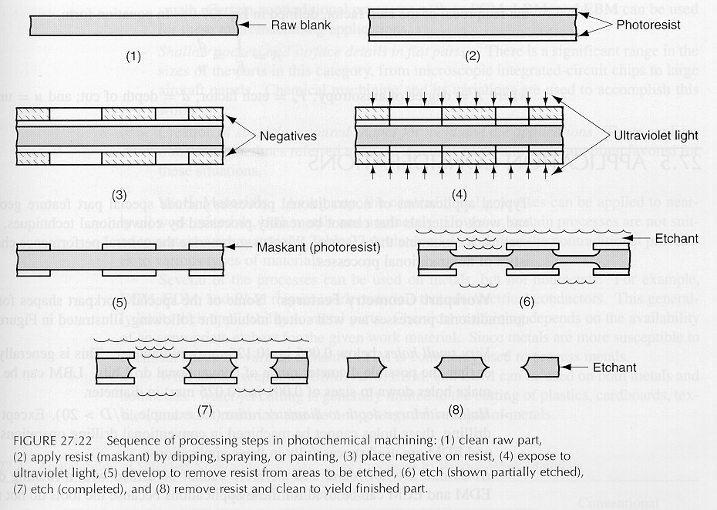
Photochemical Blanking

Slide 9
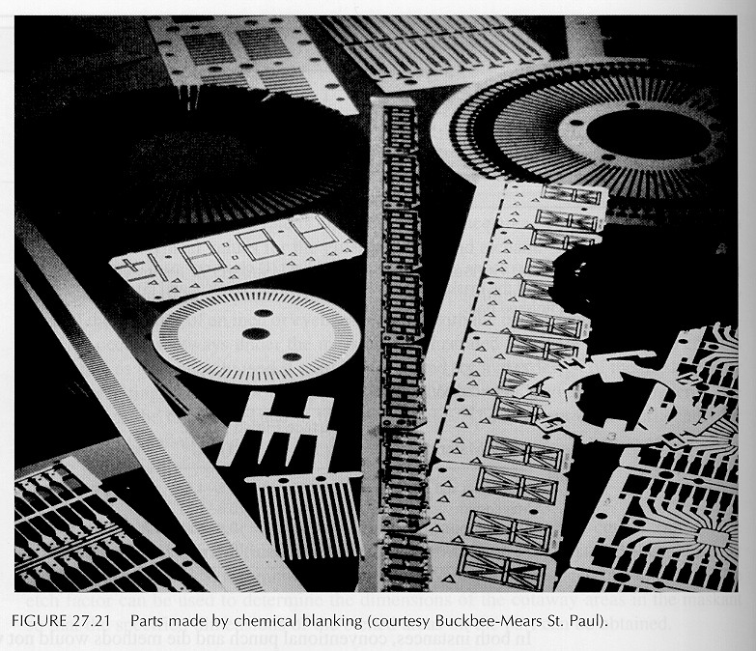
Examples of Parts

Slide 10
Photochemical Blanking
Procedure:
Prepare the design at a magnification of up to 100x; make a photographic negative and reduce it to the size of the part
Coat the blank with photosensitive material
Place the negative over the part and expose it to ultraviolet light to harden the exposed photosensitive coating
Dissolve the unexposed coating
Apply the chemical reagent
Remove the masking and wash the part

Slide 11
Chemical Machining
Design Considerations:
Avoid sharp corners, deep narrow cavities, steep tapers, folded seams and porous workpieces
Undercuts may develop
Most of the workpiece should be shaped by other processes to speed production
Variations may occur depending onhumidity and temperature
Computerized designs must be converted to a format compatible with the photochemical artwork equipment

Slide 12
Electrochemical Machining
Uses an electrolyte and electrical current to ionize and remove metal atoms
Can machine complex cavities in high-strength materials
Leaves a burr-free surface
Not affected by the strength, hardness or toughness of the material

Slide 13
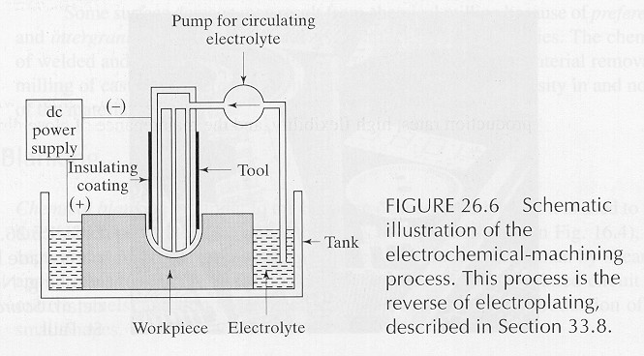
Electrochemical Machining

Slide 14
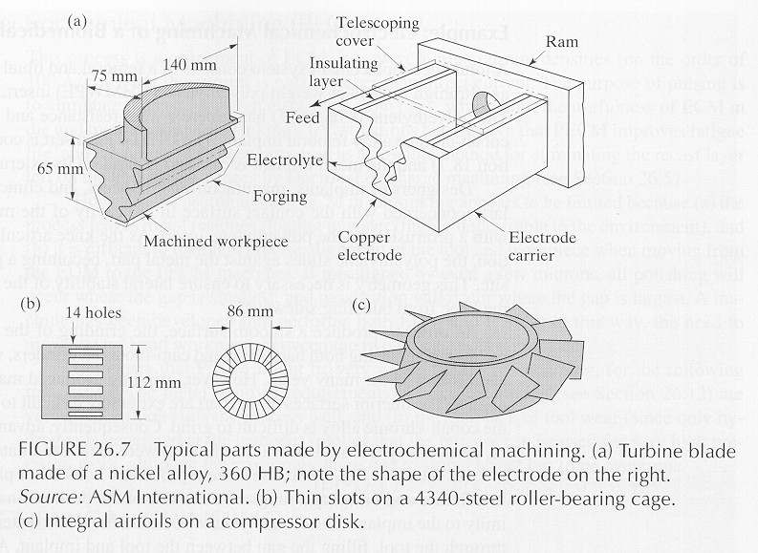
Electrochemical Machining

Slide 15
Electrochemical Machining
Design Considerations:
The electrolyte erodes away sharp profiles
It is difficult to control electrolyte flow; irregular cavities may not be formed accurately
Allow for small taper in holes made this way

Slide 16
Pulsed Electrochemical Machining
A form of electrochemical machining; the current is pulsed to eliminate the need for high electrolyte flow
Improves fatigue life of the part

Slide 17
Electrochemical Grinding
Uses a rotating cathode embedded with abrasive particles for applications comparable to milling, grinding and sawing
Most of the metal removal is done by the electrolyte, resulting in very low tool wear
Adaptable for honing

Slide 18
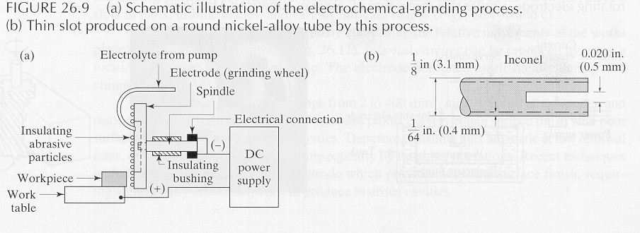
Electrochemical Grinding

Slide 19
Electrochemical Grinding
Design Considerations:
(in addition to those for electrochemical machining)
Avoid sharp inside radii
Flat surfaces to be ground should be narrower than the width of the grinding wheel

Slide 20
Electrical-Discharge Machining
Uses a shaped electrode and electric sparks to remove metal; discharges sparks at about 50-500 kHz
A dielectric (nonconductive) fluid removes debris and acts as an insulator until the potential difference is high enough
Can be used on any material that conducts electricity

Slide 21
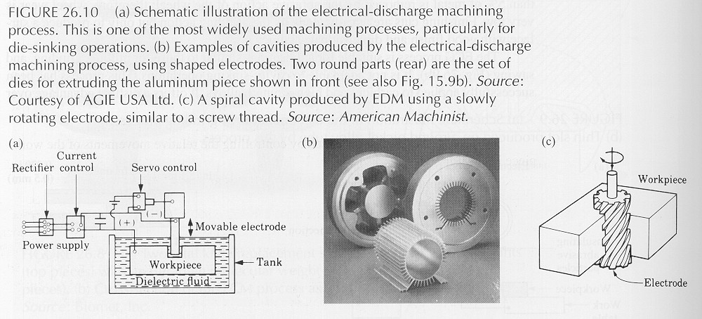
Electrical-Discharge Machining

Slide 22
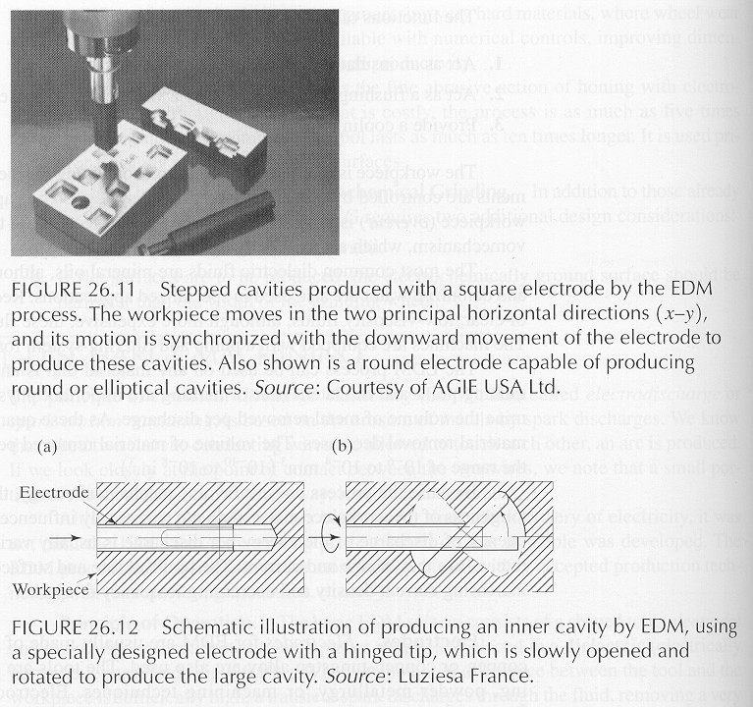
Electrical-Discharge Machining

Slide 23
Electrical-Discharge Machining
Design Considerations:
Design parts so that the electrodes can be made economically
Avoid deep slots and narrow openings
Do not require very fine surface finish
Most of the material removal should be done by other processes to speed production

Slide 24
Electrical-Discharge Grinding
The grinding wheel lacks abrasives and removes material by electrical discharges
Can be combined with electrochemical grinding
Can be used for sawing, in which the saw has no teeth

Slide 25
Electrical-Discharge Wire Cutting
The wire moves through the workpiece like a band saw, removing material by electrical discharge
Dielectric fluid is applied to the work area
The wire is generally used only once; it is inexpensive

Slide 26
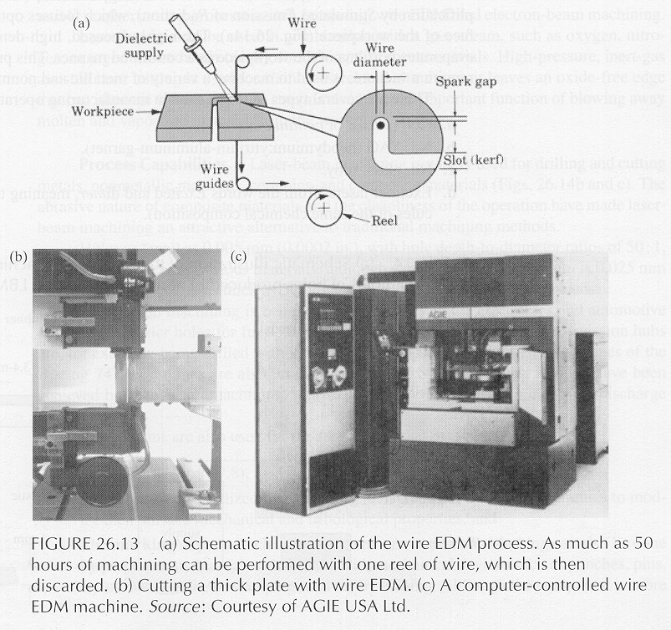
Electrical-Discharge Wire Cutting

Slide 27
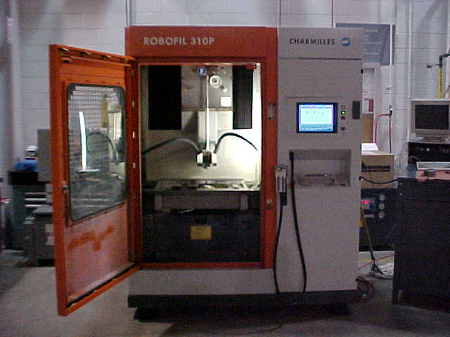
Electrical-Discharge Wire Cutting
Example of a wire EDM machine
Courtesy of Edison Industrial Service Center

Slide 28
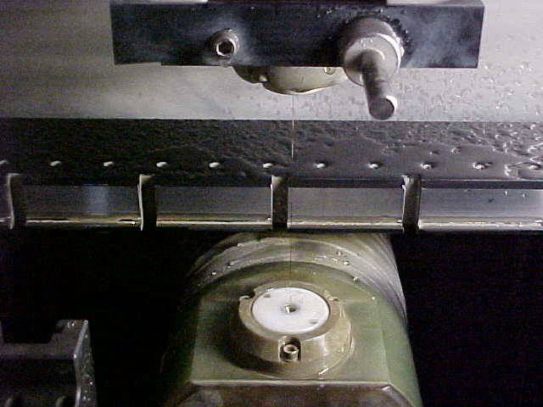
Electrical-Discharge Wire Cutting
Example of a wire EDM machine
Courtesy of Edison Industrial Service Center

Slide 29
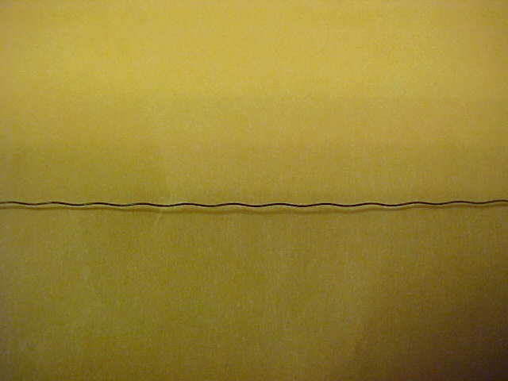
Electrical-Discharge Wire Cutting
Example of a wire used for an EDM machine
This wire has been used; the wave pattern was formed during take-up
Courtesy of Edison Industrial Service Center

Slide 30
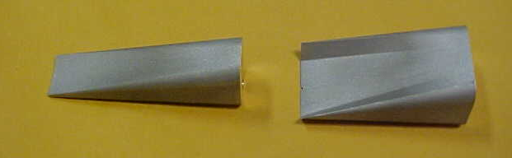
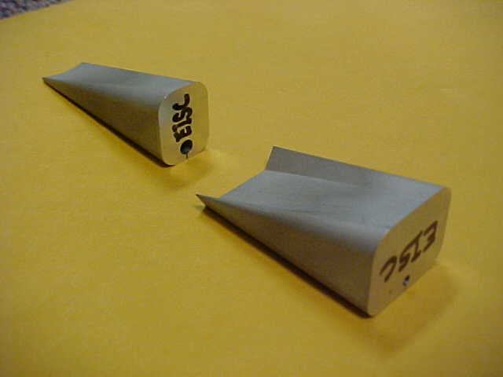
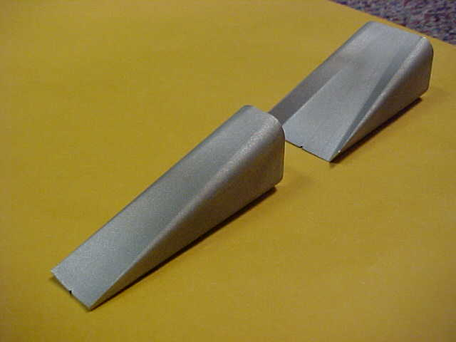
Electrical-Discharge Wire Cutting
Example of cores removed from a part using wire EDM to create the cavity in a high-pressure nozzle
Holes were drilled in the interiors so that the wire could be strung through
Courtesy of Edison Industrial Service Center

Slide 31
Laser-Beam Machining
Uses a concentrated beam of light to vaporize part of the workpiece
Usually produces a rough surface with a heat-affected zone
Can cut holes as small as .005 mm with depth/diameter ratios of 50:1

Slide 32
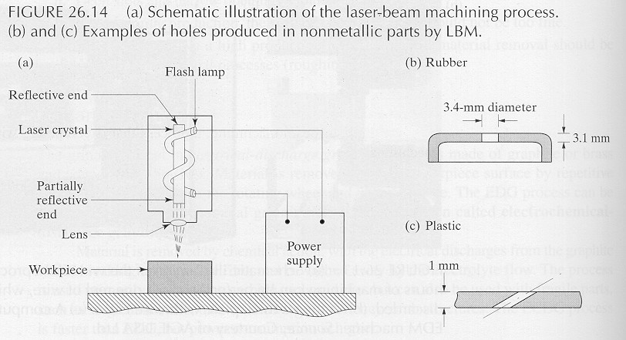
Laser-Beam Machining

Slide 33
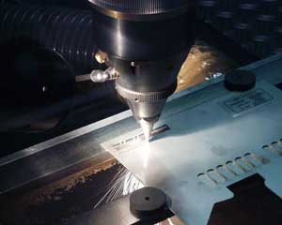
Laser-Beam Machining

Slide 34
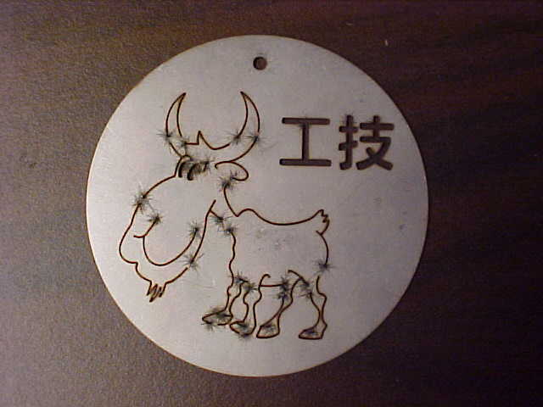
Laser-Beam Machining
Example of a part cut by laser-beam machining
Splatter marks appear where the laser first cuts into the material

Slide 35
Laser-Beam Machining
Design Considerations:
Non-reflective workpiece surfaces are preferable
Sharp corners are difficult to produce; deep cuts produce tapers
Consider the effects of high temperature on the workpiece material

Slide 36
Electron Beam Machining
Vaporizes material using electrons accelerated to 50-80% the speed of light
Produces finer surface finish and narrower cut width than other thermal cutting processes
Requires a vacuum; generates hazardous X rays

Slide 37
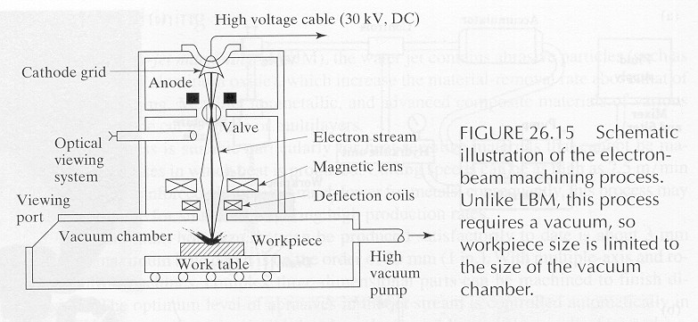
Electron Beam Machining

Slide 38
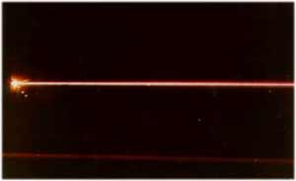
Electron Beam Machining
An electron beam in a very low-pressure atmosphere of helium

Slide 39
Plasma Arc Cutting
Uses plasma (ionized gas) to rapidly vaporize material
Material removal rates are much higher than those for laser beam machining and electron beam machining; produces good surface finish and thin cut width

Slide 40
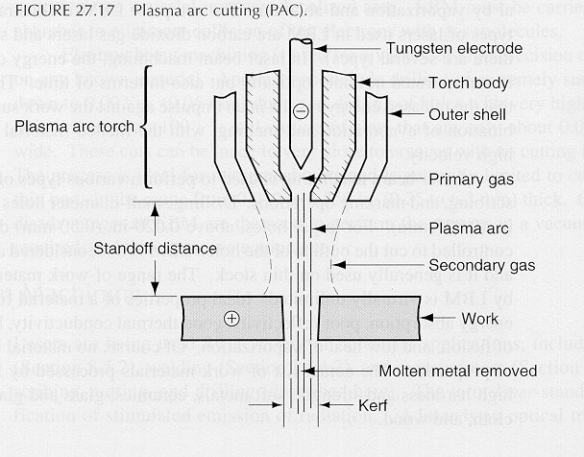
Plasma Arc Cutting

Slide 41
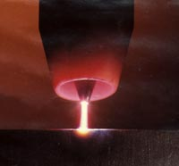
Plasma Arc Cutting
Close-up view of a plasma arc

Slide 42
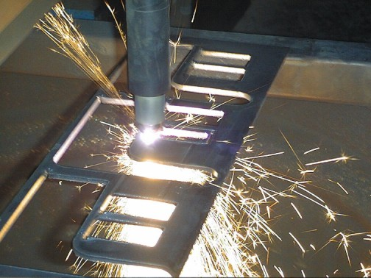
Plasma Arc Cutting

Slide 43
Electron Beam Machining and Plasma Arc Cutting
Design Considerations:
(in addition to those for laser-beam machining)
Parts should match the size of the vacuum chamber
Consider manufacturing the part as a number of smaller components

Slide 44
Water Jet Machining
A pressurized jet of water cuts a groove in the material
Effective for many nonmetallic materials
Cuts can be started at any location; does not produce heat; produces very little burring

Slide 45
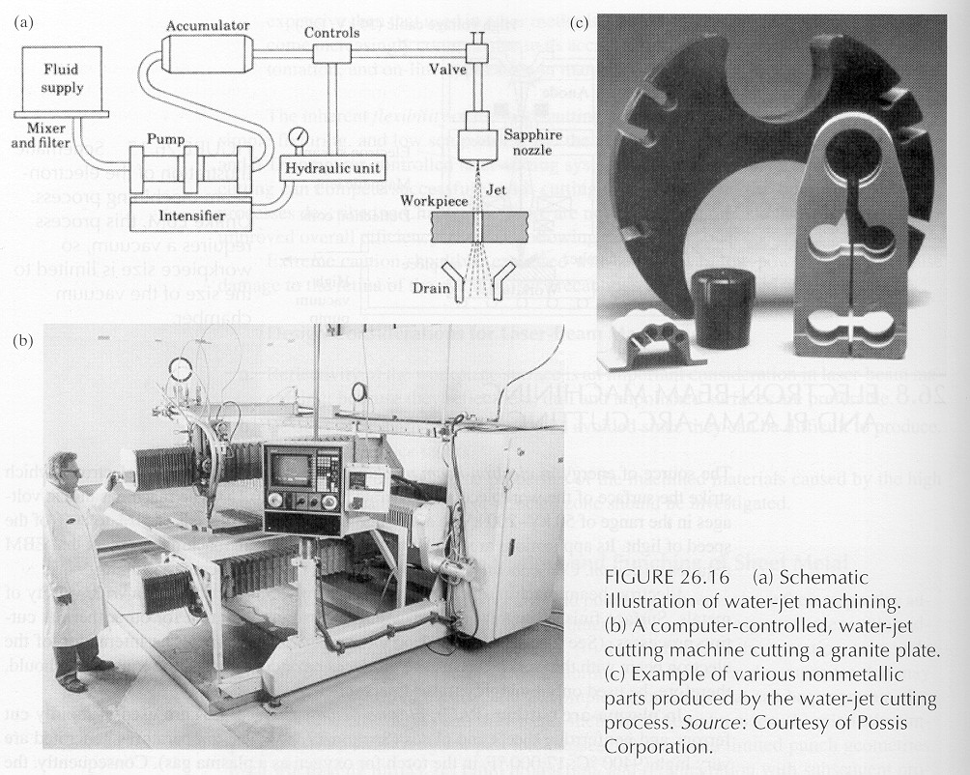
Water Jet Machining

Slide 46
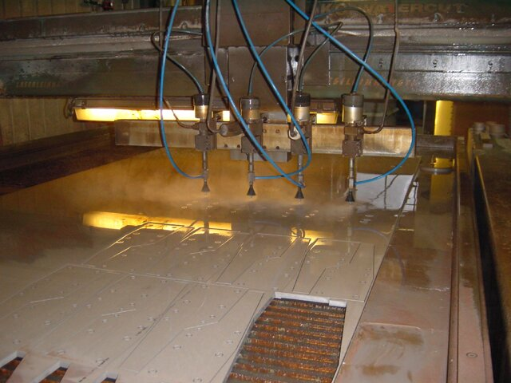
Water Jet Machining

Slide 47
Abrasive Water Jet Machining
The water jet contains abrasive particles; this increases the material removal rate
Can cut metallic, nonmetallic, and advanced composite materials
Suitable for heat-sensitive materials

Slide 48
Abrasive Jet Machining
A high-speed jet of dry air, nitrogen or carbon dioxide carries abrasive particles
Good for cutting hard or brittle materials
Can be used for deburring, cleaning, or removing oxides or surface films

Slide 49
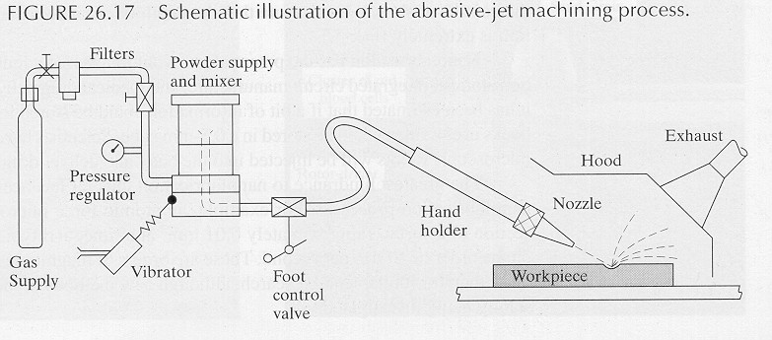
Abrasive Jet Machining

Slide 50
Summary
Advanced machining processes offer alternatives where conventional procedures would be insufficient or uneconomical

Slide 51

The End

